Slide 1
OCI-C to OCI Migration
How to request using SEaaS

Slide 2
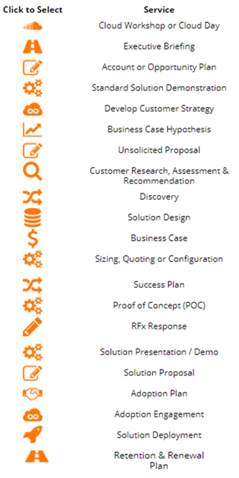
Using “Solution Design” Service
Enter Opportunity ID
Select Solution Design Service
Answer question 3 “NATD: Name any specific program (such as OCI-C to OCI Migrations) that this is associated with?” with OCI-C to OCI Migrations
The service will be routed to the delivery team

Slide 3
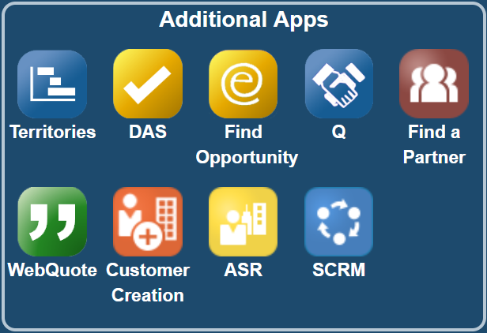
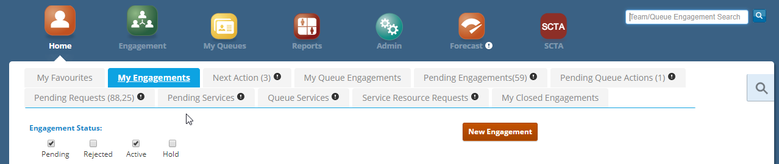

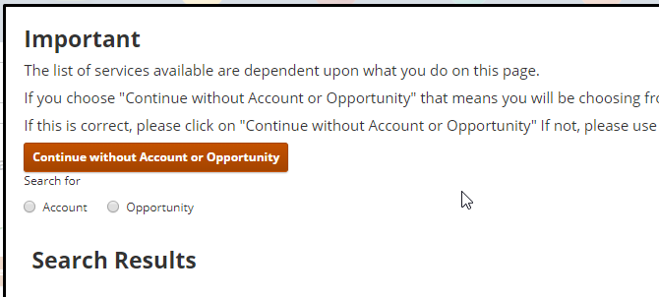
SEaaS Login to SCRM and go to New Engagement
Login to SCRM
Select Opportunity
Solution Design Service will only show when an Opportunity is used

Slide 4
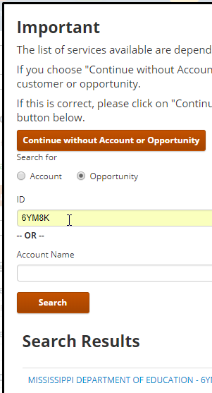
SEaaS Select ‘Solution Design’ Service
Opportunity
Enter Opportunity ID
Or Part of Account Name
Select Service

Slide 5
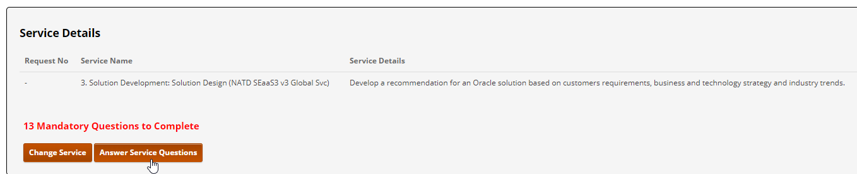
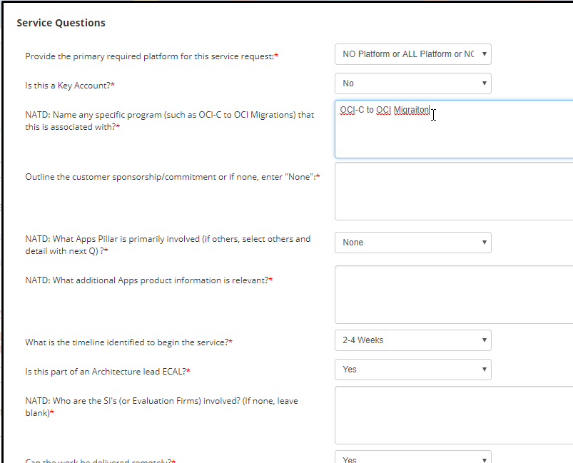


SEaaS Answer Service Specific questions
Answer Service Questions, Enter ‘OCI-C to OCI Migration’ for Question 3
Answer all questions as normal
Enter OCI-C to OCI on Q3
Complete Engagement Header if required

